Slide 1
Session Four

Slide 2
How do FPGA do Math?

Slide 3
Why do we need to do math in FPGA
Programmable Logic enables accelerated applications
Image Processing – Noise removal, edge detection, filtering
Radar Processing – Signal generation, reply processing
Signal Processing – Signal filtering & manipulation
Robotics – End Effector positioning, Navigation
Control Systems – Kalman Filtering, PID Loops
Motor Control – Servo Motor, DC Motor Control
All these applications require the ability of FPGA to do Maths and implement algorithms.

Slide 4
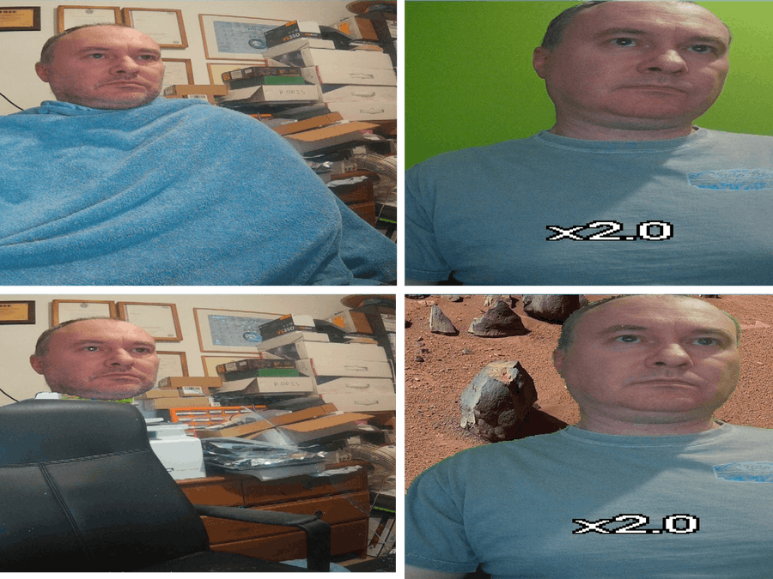

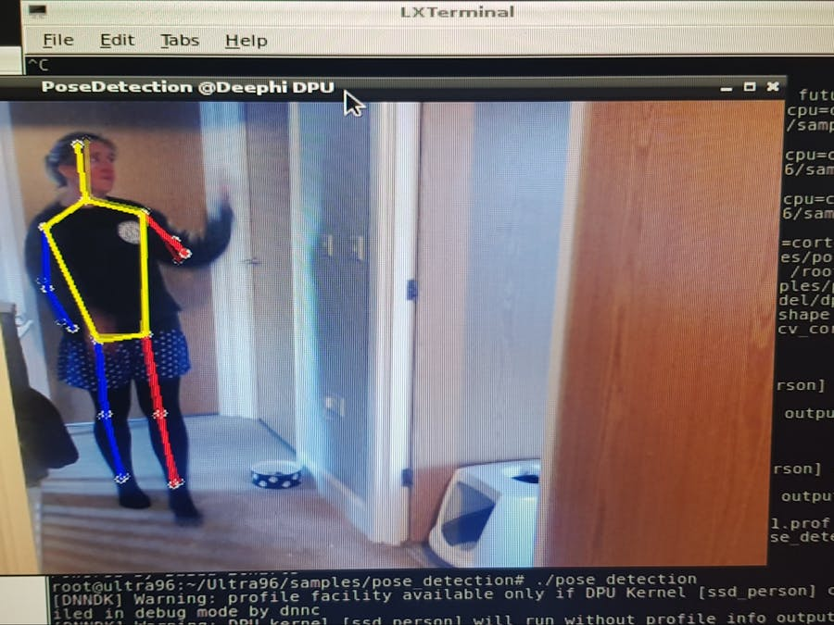
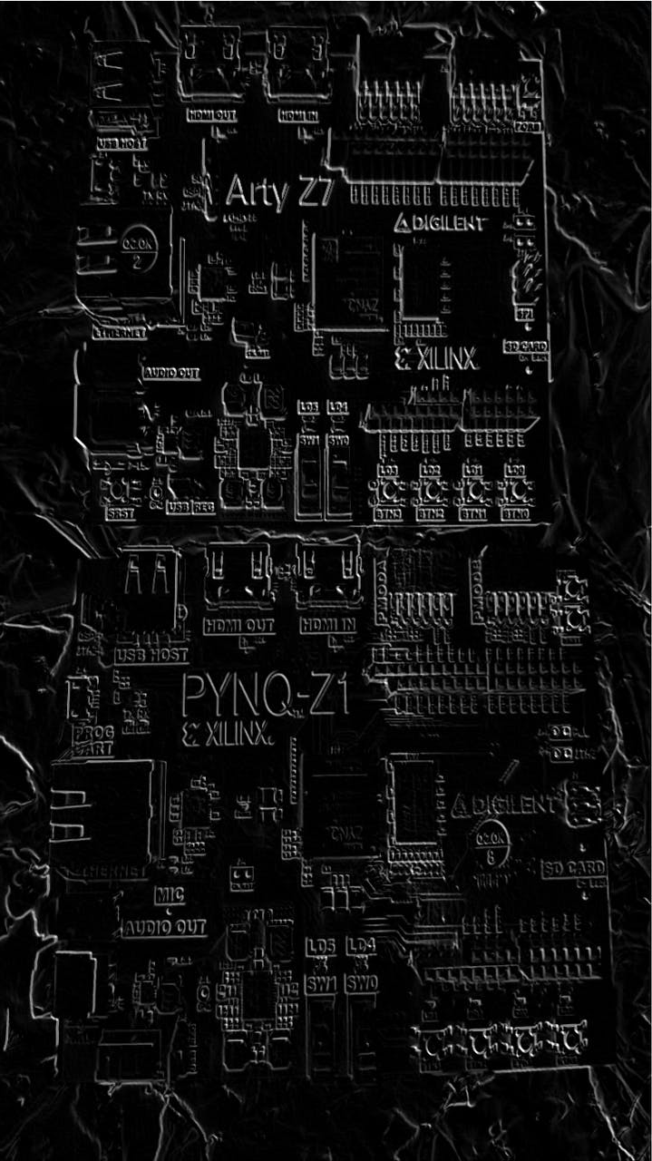
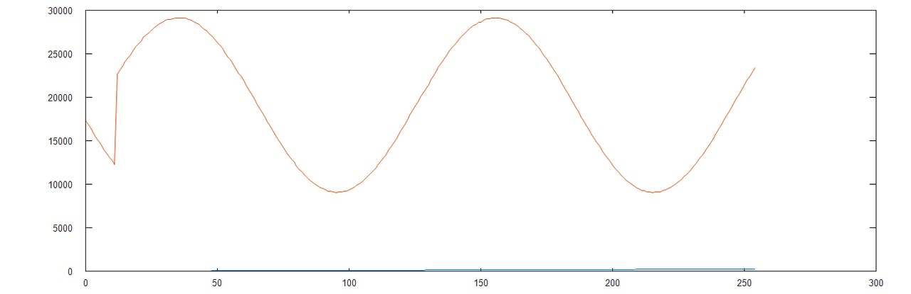
Example applications
Background Removal & Substitution
Edge Detection
Fractals
AI/ML
Signal Processing

Slide 5
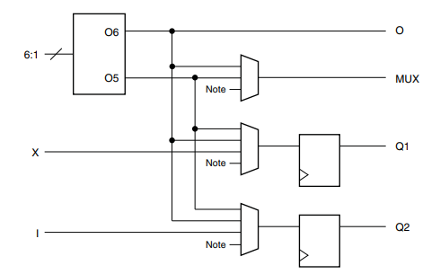
FPGA Architecture
FPGA are register and logic rich
Configurable Logic Blocks contain
Registers
Look Up Table
Distributed RAM
Carry Mux
Logic resources are the basic building blocks of our algorithms. It is where we implement our mathematical algorithms

Slide 6
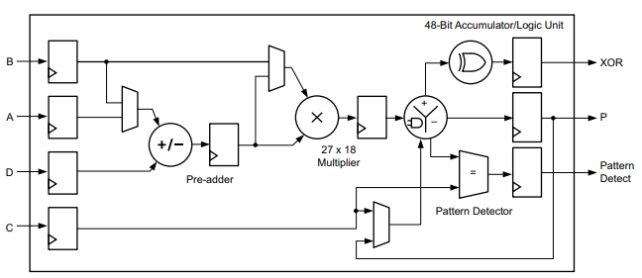
DSP Elements
Implementing math directly in logic is costly
Resources – increased resources
Performance – reduced performance
Manufactures to address this include dedicated DSP elements e.g. DSP48
Capable of doing 48 bit Multiply accumulator
Pre-Adder
Multiply
Accumulator
Can do advance things SIMD – More later!

Slide 7
FPGA Math's
So far, we have looked at Logic & DSP elements, but they all have one thing in common ?
They are all ideal for the implementation of fixed-point solutions.
What is the difference between fixed point and floating-point numbers ?

Slide 8
Fixed Point Number
Fixed-point representation maintains the decimal point within a fixed position allowing for straight forward arithmetic operations.
The major drawback of fixed-point representation is that to represent larger numbers or to achieve a more accurate result with fractional numbers, a larger number of bits are required.
A fixed-point number consists of two parts called the integer and fractional parts.
But in programmable logic Fixed Point Maths can be very fast

Slide 9
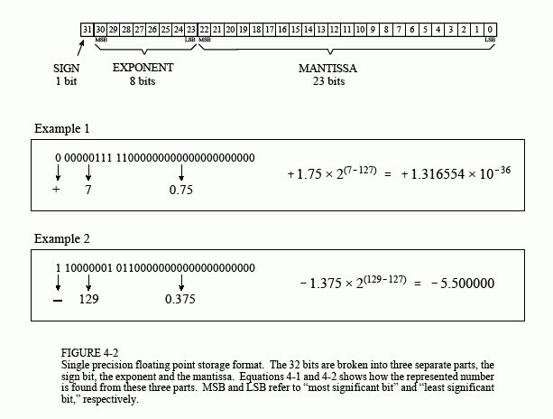
Floating Point Number
Floating point representation allows the decimal point to float to different places within the number depending upon the magnitude.
The floating-point number is standardized by an IEEE / ANSI Standard 754-1985 the basic IEEE floating point number

Slide 10
Why Fixed Point
Less complex to implement in logic
Enables a faster solution
Can be more power efficient
FPGA are register rich!
No standard for implementation but, Q format is popular
Q15 – 15 fractional bits
M,N – M integer bits and N fractional bits

Slide 11
Number schemes
Fixed point numbers need to represent positive and negative numbers
Sign and Magnitude - Utilises the left most bit to represent the sign of the number (0 = positive, 1 = negative) the remainder of the bits represent the magnitude. BUT! Positive and Negative Numbers
Ones Complement – Same unsigned representation for positive numbers as Sign and Magnitude representation. However, for negative numbers the inversion (ones complement) of the positive number are used. Requires end around carry for subtraction – Added complexity.
Twos Complement – Positive are represented in the same manner as an unsigned numbers. While negative numbers are represented as the binary number you add to a positive number of the same magnitude to get zero

Slide 12
Twos Compliment
A negative twos complement number is calculated by first taking the ones complement (inversion) of the positive number and then adding one to it. The twos complement number system allows subtraction of one number form another by performing an addition of the two numbers. The range a twos complement number can represent is given by
(2n-1) to + (2n-1 – 1)
One method we can use to convert a number to its twos complement format is to work right to left leaving the number the same until the first one is encountered, after this each bit is inverted.

Slide 13
Fixed Point
How many bits do we need to represent my value ?
For example, the number of integer bits required to represent a value between 0.0 and 423.0

Slide 14
Fixed Point
How do we work out fractional bit ? Trade off between bit length and accuracy
To store the number 1.45309806319x10-4
Multiply by 2^16 1.45309806319x10-4 * 65536 = 9.523023
Can only store 9 in the FPGA registers.
9/65536 = 1.37329101563x10-4
Significant loss of accuracy, how can we address this?

Slide 15
Fixed Point
We can obtain a more accurate result by scaling the number up by a factor of 2 that produces a result of between 32768 and 65535 therefore still allowing storage in a 16-bit number
268435456 * 1.45309806319x10-4 = 39006.3041205
Stored number therefore 1.45308673382x10-4 (39006/ 268435456)
Number is formatted as Q28 or 1,28

Slide 16
Fixed Point Rules
Fixed Point Arithmetic does have some rules which must be followed.
Addition - Decimal points must be aligned
Subtraction – Decimal points must be aligned
Division – Decimal Points must be aligned
Multiplication – Decimal points do not need to be aligned

Slide 17
Fixed Point Result Sizes
Operation
A + B | Max(A’left, B’left) + 1 downto Min (A’right, B’right)
A - B | Max(A’left, B’left) + 1 downto Min (A’right, B’right)
A * B | (A’left + B’left) + 1 downto A’right + B’right
A / B - Unsigned | A’left - B’left downto (A’right + B’right) -1
A / B - Signed | (A’left - B’left) +1 downto A’right + B’right

Slide 18
Implementing in VHDL
Two options
Numeric Standard (pre VHDL 2008)
Unsigned
Signed
Need to keep track of decimal point – Range of number from X downto 0
Quantisation needs to be performed by developer
No in-built checking, requires design to check correct sizing / overflow etc
Fixed Point (VHDL 2008)
Ufixed
Sfixed
Decimal point located between the 0 and -1 bit
Inbuilt checking to ensure correct sizing of results

Slide 19
Fixed Package
Integer bits are represented in the range MSB down to 0
Fractional bits are represented in the range -1 down to LSB
SIGNAL example : ufixed(3 DOWNTO -3);
Which represents the vector of 000.000 allowing for a range of 0.0 to 7.875
To help initialise signals, variables and constants in our algorithm we can use the to_ufixed and to_sfixed, these can be used with integers, real, ufixed, sfixed and std_logic_vectors.

Slide 20
What about more complex math
How would I implement the following functions
Sine / Cosine / ArcTan
SineH / CosH / ArcTanH
Square Root
Exponential
Ln
Taylor / Maclaurin Series? Look Up Table ?
But how do we achieve performance ?

Slide 21
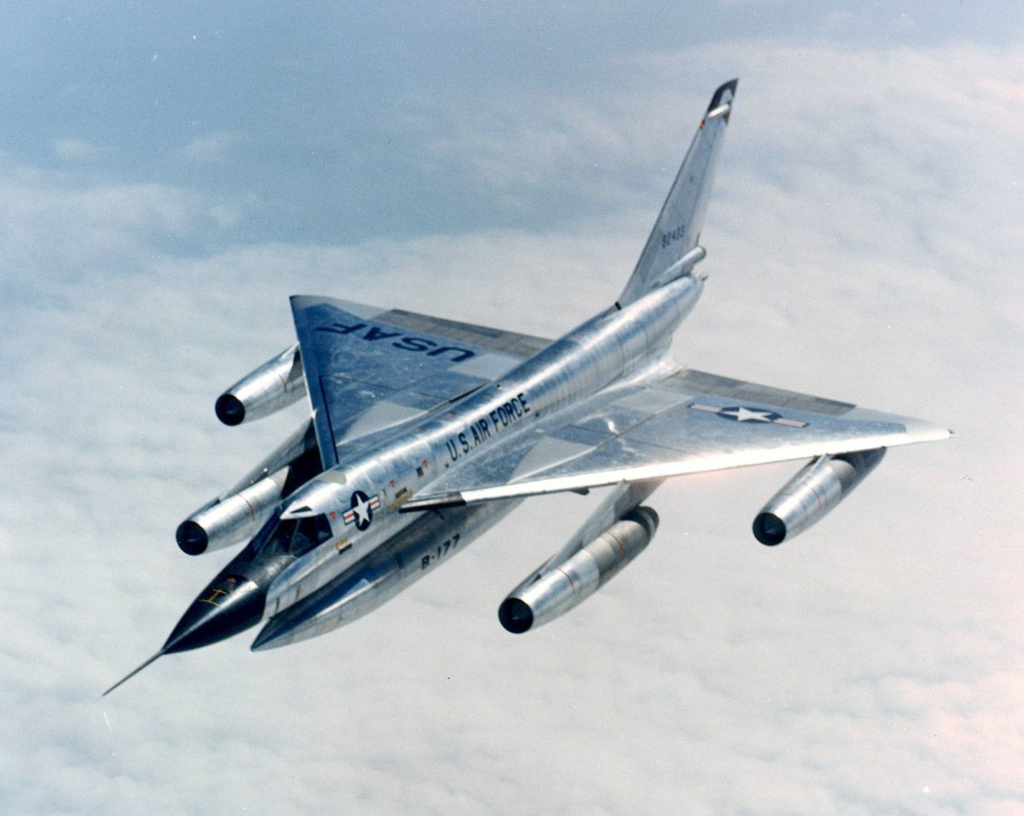
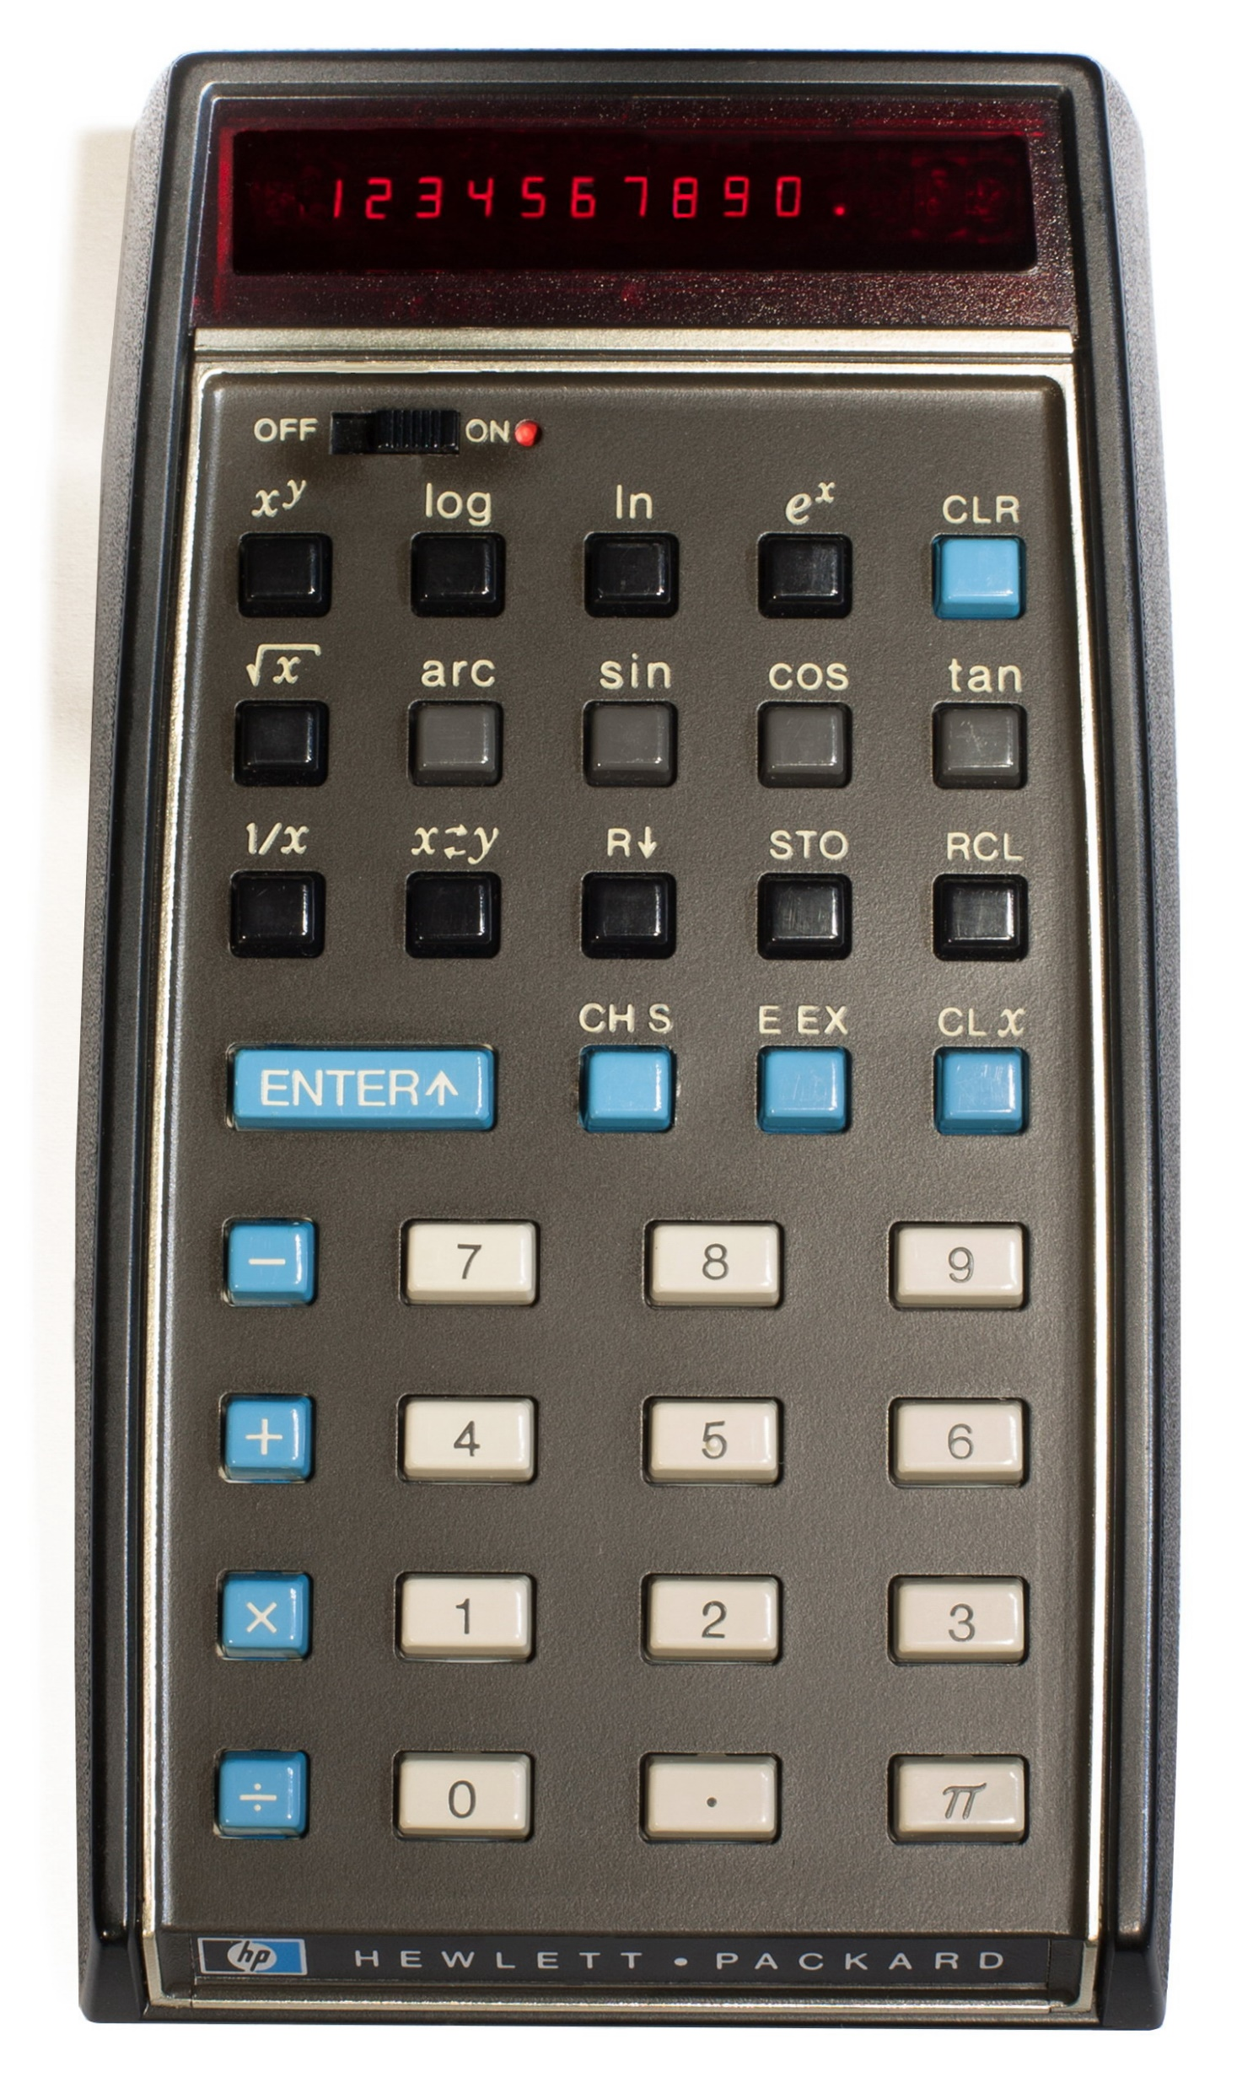
CORDIC Algorithm
CORDIC (COordinate Rotation DIgital Computer) algorithm invented by Jack Volder for B58 Program
Deployed in first scientific calculator HP35
Shift and Add algorithm which can be used to implement transcendental functions.
No dedicated Multiplier required.

Slide 22
CORDIC Algorithm
Three configurations - Linear / Hyperbolic / Circular
Each mode has two modes – Rotation / Vectoring
Enable a range of complex math's functions to be implemented.
Additional Functions
Tan = Sin / Cos
TanH = Sinh / Cosh
Exponential = Sinh + Cosh
Natural Logarithm = 2 * ArcTanH ^{note 1}
SQR = (X² – Y²)^{0.5}

Slide 23

More Complex Algorithm
How would you implement the following algorithm
Typical Platinum Resistance Thermometer conversion equation used in industrial applications
$$t= \frac{−R_{0}×a+\sqrt{R_{0}^{2}×a^{2}−4×R_{0}×b×(R_{0}−R)}}{2×R_{0}×b}$$

Slide 24
More Complex Algorithm

Slide 25
Polynomial Approximation

Slide 26
Polynomial Approximation
Leverage FPGA DSP rich environment – Addition and Multiplication easy to do in FPGA especially as we now know how!
If Accuracy is difficult with one overall polynomial equation – Segment it to several elements
Uniform segmentation
Non-uniform segmentation

Slide 27
What about signal processing
Finite Impulse Response Filters – Leverage the Multiple Accumulate Capability
Assume an ideal filter in the frequency domain – Brick Wall

Slide 28
FIR Filter
IFFT of the brick wall filter gives us the Windowed Sync Pulse
The ripples extend to infinity and never settle to zero.

Slide 29
FIR Filter
Truncating the impulse response gives us ripples – Windowing helps address this

Slide 30
FIR Filter
Filter Response is improved with window

Slide 31
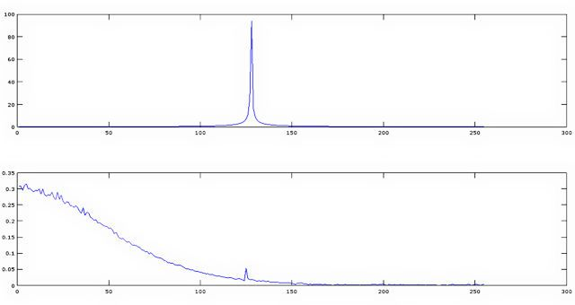
FIR Filter
When Implemented (Input top / Output bottom)

Slide 32
What is PYNQ – Introduction to PYNQ framework

Slide 33
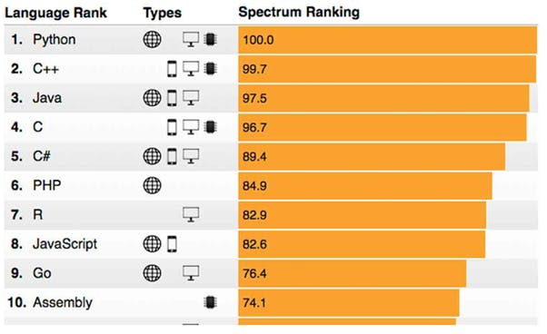
What is PYNQ?
PYNQ is an open source project started by Xilinx, which fuses the productivity of Python with the acceleration provided by programmable logic within the Zynq / Zynq MPSoC
Hosted at PYNQ.io

Slide 34
Why should I learn PYNQ ?
Tight coupling of processing system (PS) and programmable logic (PL) in the Zynq / Zynq MPSoC creates a system which is
Responsive – Leverage the parallel processing capability provided by the PL
Deterministic – Creates processing pipeline competing for fewer shared resources
Power Efficient – Less off chip transactions to or from DDR memory, dedicated hardware implementation is more efficient than
PYNQ frees Python programmers from the sequential software world and opens up the acceleration of programmable logic without the need to be a digital designer.

Slide 35
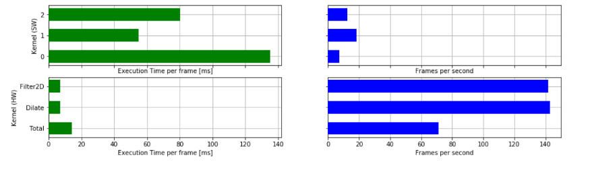
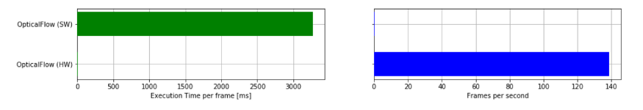
Why should I learn PYNQ ?
Simple example of PYNQ in a image processing application
Image Filtering
SW < 20 Frames per Second
HW > 60 Frames per Second
Optical Flow
SW < 1 Frame per Second
HW > 120 Frames per Second

Slide 36
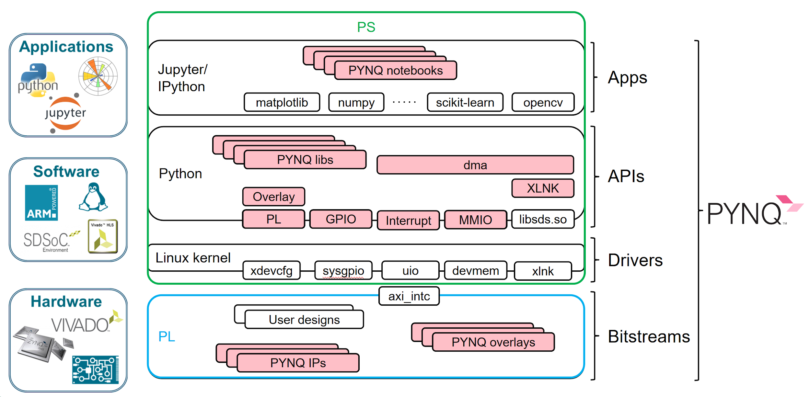
PYNQ Framework: interfacing Python with Xilinx SoC

Slide 37
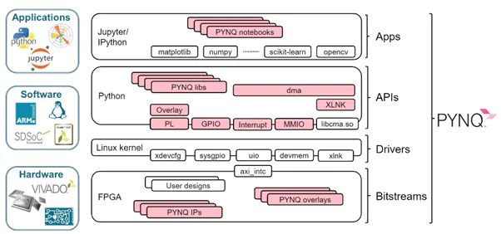
PYNQ Components
To achieve performance PYNQ is comprised of
Jupyter Notebooks
PYNQ Package
PYNQ Libs
PYNQ Classes
PYNQ IP
PYNQ Overlays

Slide 38
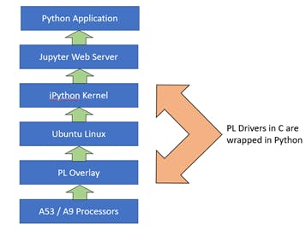
PYNQ Architecture
Pynq is built upon Xilinx Petalinux flow
Standard way to create PYNQ for a custom board is via petalinux BSP as we will see

Slide 39
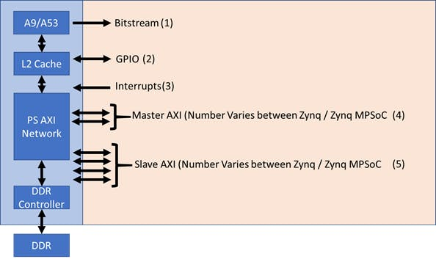
Working with the PL
Bitstream — This configures the programmable logic for the desired application. In the PYNQ framework, the xdevcfg driver is used.
GPIO — This provides simple IO in both directions. In the PYNQ framework, this is supported by the sysgpio driver.
Interrupts — Support interrupt generation from the programmable logic to the processing system. In the PYNQ framework, this is supported by the Userspace IO driver.
Master AXI Interfaces — These are used to transfer data between the PS to the PL when the PS is the initiator of the transaction. The PYNQ framework uses devmem when employing master AXI interface.
Slave AXI Interfaces — These are used to transfer data between the PS and PL when the PL is the initiator of the transaction. The PYNQ framework uses xlnk to enable these transfers.

Slide 40
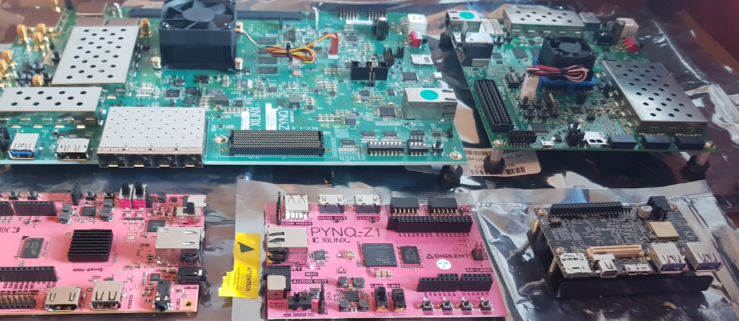
Available PYNQ boards
Several PYNQ builds for existing boards:
Pynq Z1 — Zynq SoC 7020 & Arty Z7-20
Pynq Z2 — Zynq SoC 7020
ZCU104 — Zynq MPSoC XCZU7EV
ZCU111 — Zynq RFSoC XCZU28DR
Ultra96 — Zynq MPSoC ZU3EG

Slide 41
Overlays
Overlays are the design loaded into the programmable logic
Can be custom created or accessed via the PYNQ.IO community
Range of Overlays in the community including
Machine Learning
Image Processing
RISC-V
Kalman filter
Base Overlay is the initial overlay which is created with the PYNQ Image
Download and work with new overlays as required
Of course you can also create you own – As we will see

Slide 42
PYNQ Libraries
PYNQ provides several libraries which provide support for management of the processor and allow access to the low level hardware including
IP Cores – Audio, AXI GPIO, AXI IIC, DMA, Logic Tools, Video
IOP – Arduino, Grove, RPI, PMOD
PYNQ MicroBlaze – MicroBlaze Subsystem RPC and Library
PS / PL Interface – Interrupt, MMIO, PS GPIO, Xlnk
PS Control – PMBus
PL Control – Overlay, PL and Bitstream Classes

Slide 43
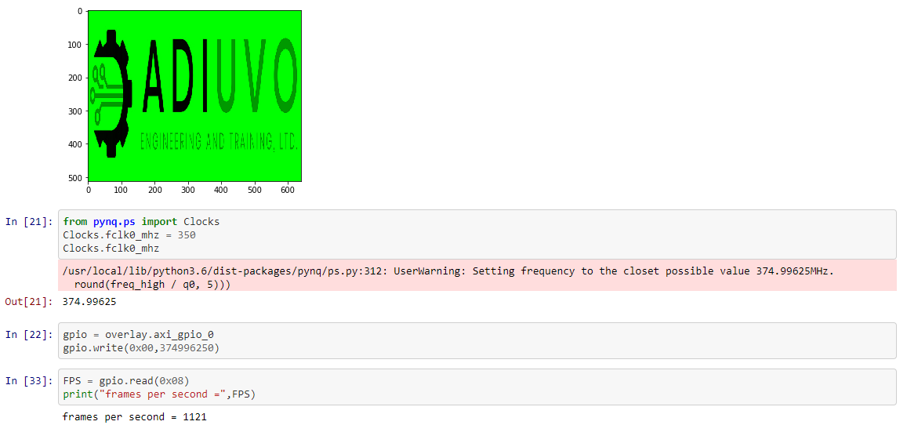
PYNQ In Industry
Working with THALES – Major Defense Client – High Speed Image processing (3000 > 10,000 FPS)
ZCU102 Development board
“The use of Pynq to rapidly test and evaluate design patterns for image processing has been invaluable. Not only has it sped up design, but it also reduces the necessary team size to a manageable level.”

Slide 44
Vitis AI

Slide 45
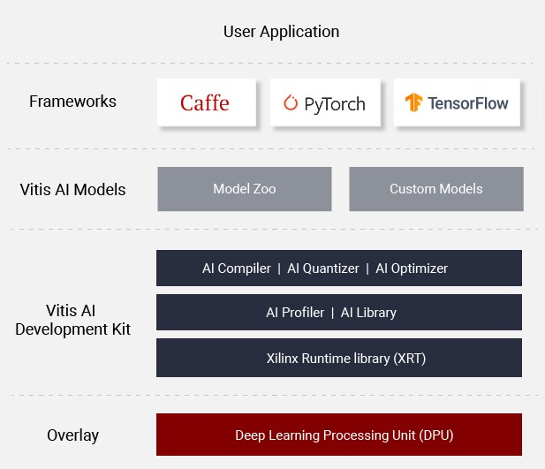
Vitis AI Development Environment
Vitis AI enables acceleration of AI inference at edge & Cloud
Supports leading frameworks such as TensorFlow, Caffe and Pytorch
Works with fixed point representation and Xilinx Deep Learning Processor Unit

Slide 46
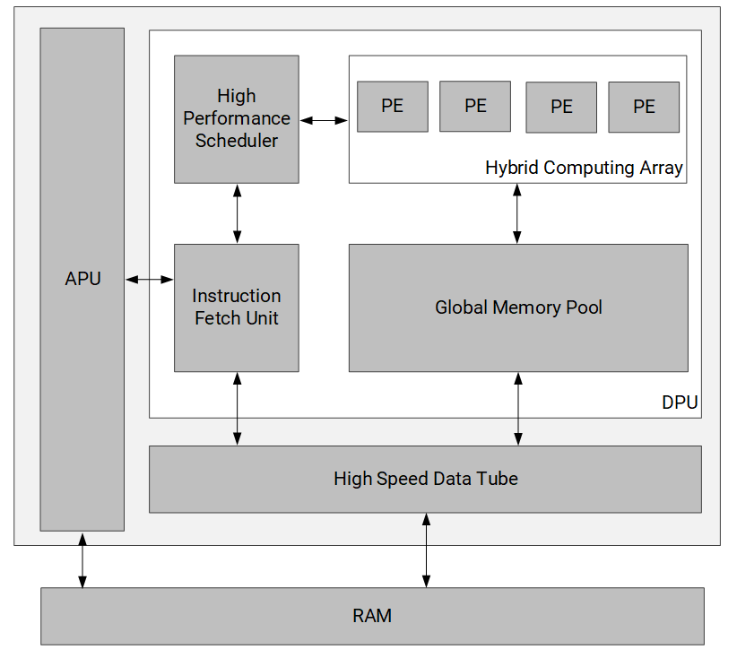
Deep Learning Processing Unit
Deep Learning Processing Unit (DPU) is a programmable engine optimized for convolutional neural networks
Can be used to implement
VGG, ResNet, GoogLeNet, YOLO, SSD, MobileNet, and FPN

Slide 47
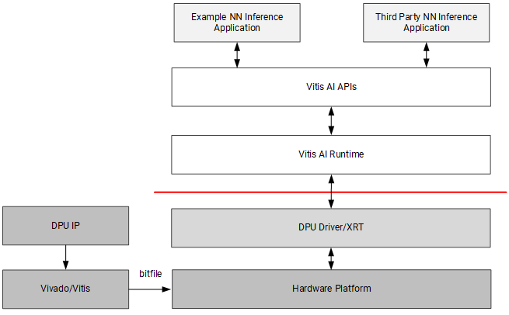
DPU Development flow
Use Vitis / Vivado to generate bit stream
Vitis AI to generate the neural network.
Can come from Xilinx Model Zoo

Slide 48
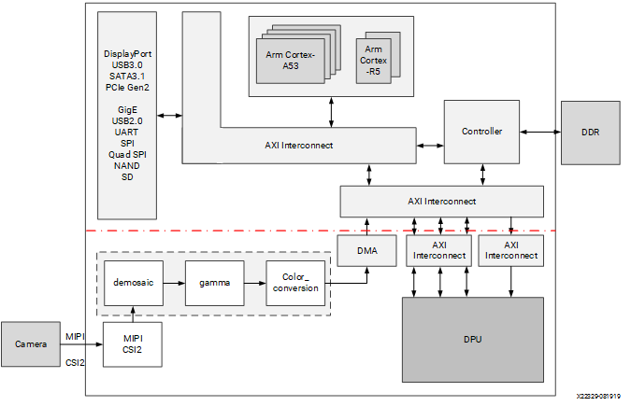
Example Application
AI is only a small part (but important part) of the solution
Need to be able to get image into or out of the system.
For example, MIPI camera interface

Slide 49
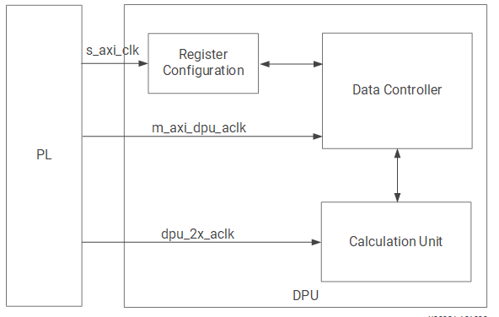
Clocking the DPU
s_axi_aclk is used for the register configuration module. This module receives the DPU configuration though the S_AXI interface. The S_AXI clock can be configured as common with the M-AXI clock or as an independent clock.
The primary function of the data controller module is to schedule the data flow in the DPU IP. The data controller module works with m_axi_dpu_aclk. The data transfer between the DPU and external memory happens in the data controller clock domain, so m_axi_dpu_aclk is also the AXI clock for the AXI_MM master interface in the DPU IP
The DSP slices in the computation unit module are in the dpu_2x_clk domain, which runs at twice the clock frequency of the data controller module. The two related clocks must be edge-aligned.

Slide 50
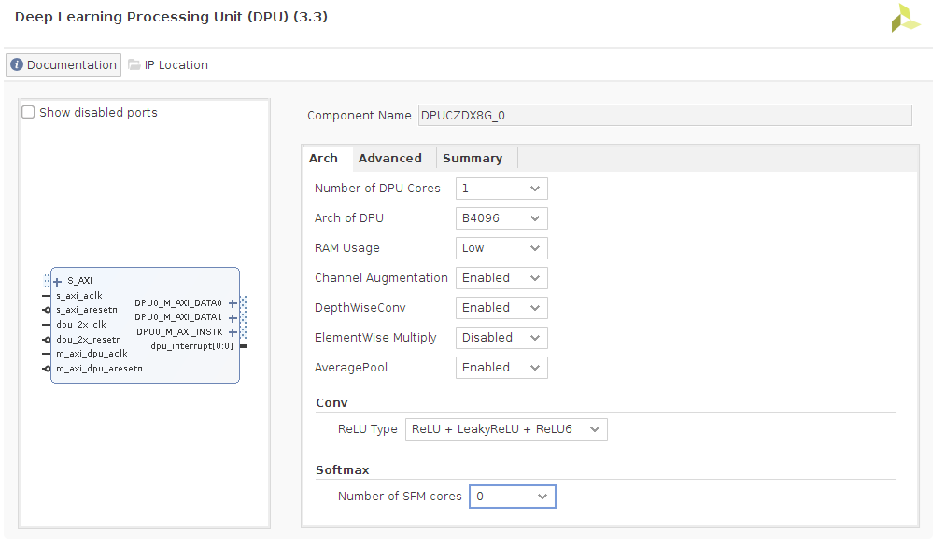
DPU is configurable
Depending on flow either IP integrator or in script (Vitis)
Can control performance and resource usage
Can be deployed in

Slide 51
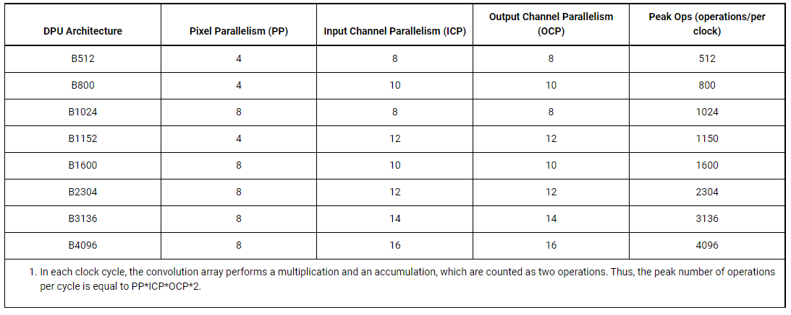
Performance Optimisation

Slide 52
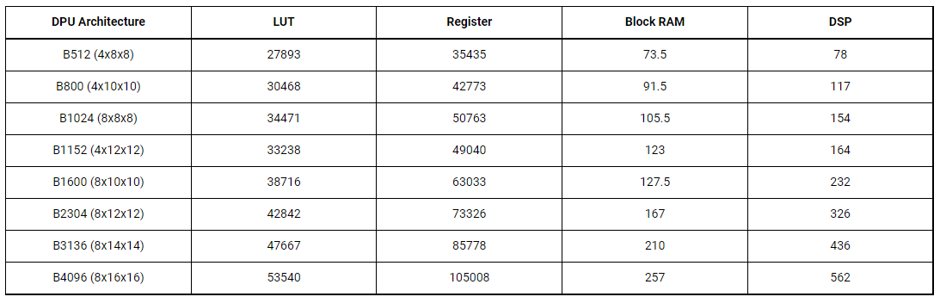
Resource Optimization

Slide 53
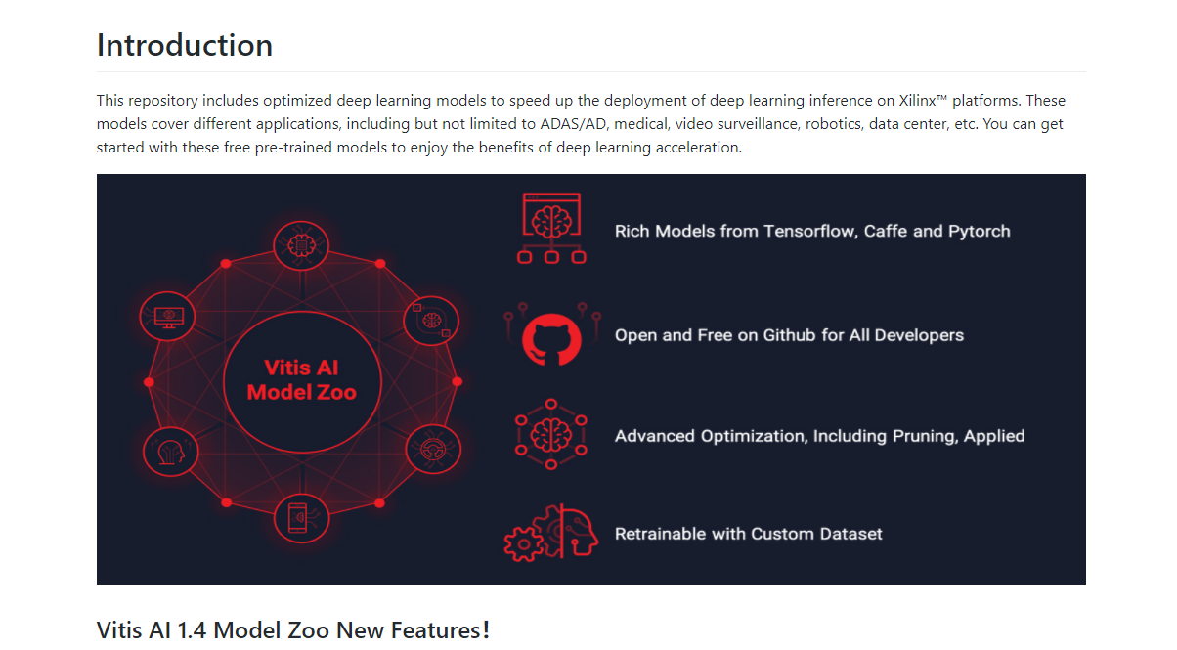
Model Zoo
Networks and many others are often made available for different frameworks in a Model Zoo

Slide 54
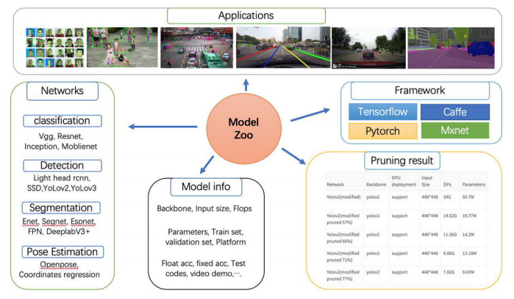
Model Zoo

Slide 55
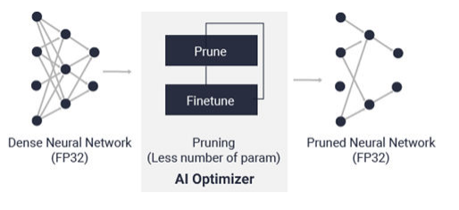
Vitis AI Optimizer
Optimizes the network
Reduce model complexity by 5x to 50x with minimal accuracy degradation
Requires a commercial license

Slide 56
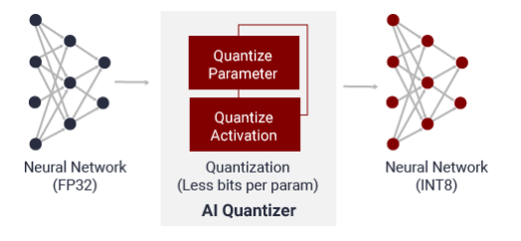
Vitis AI Quantizer
Converts the 32-bit floating-point weights and activations to fixed-point e.g. INT8
Fixedpoint network model requires less memory bandwidth, thus providing faster speed and higher power efficiency than the floating-point mode

Slide 57
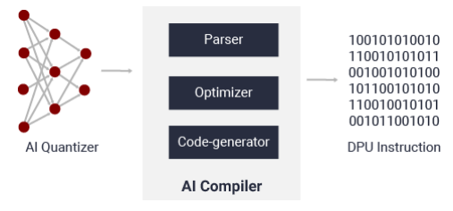
Vitis AI Compiler
Maps the AI model to the instruction set and dataflow model
Performs optimizations such as
layer fusion,
instruction scheduling
reuses on-chip memory.

Slide 58
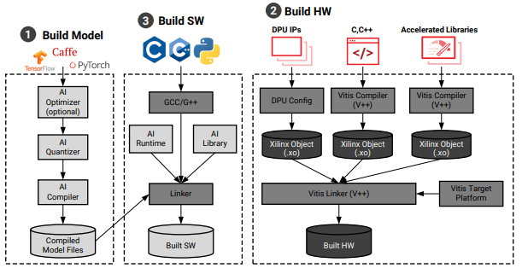
Putting it all Together

Slide 59

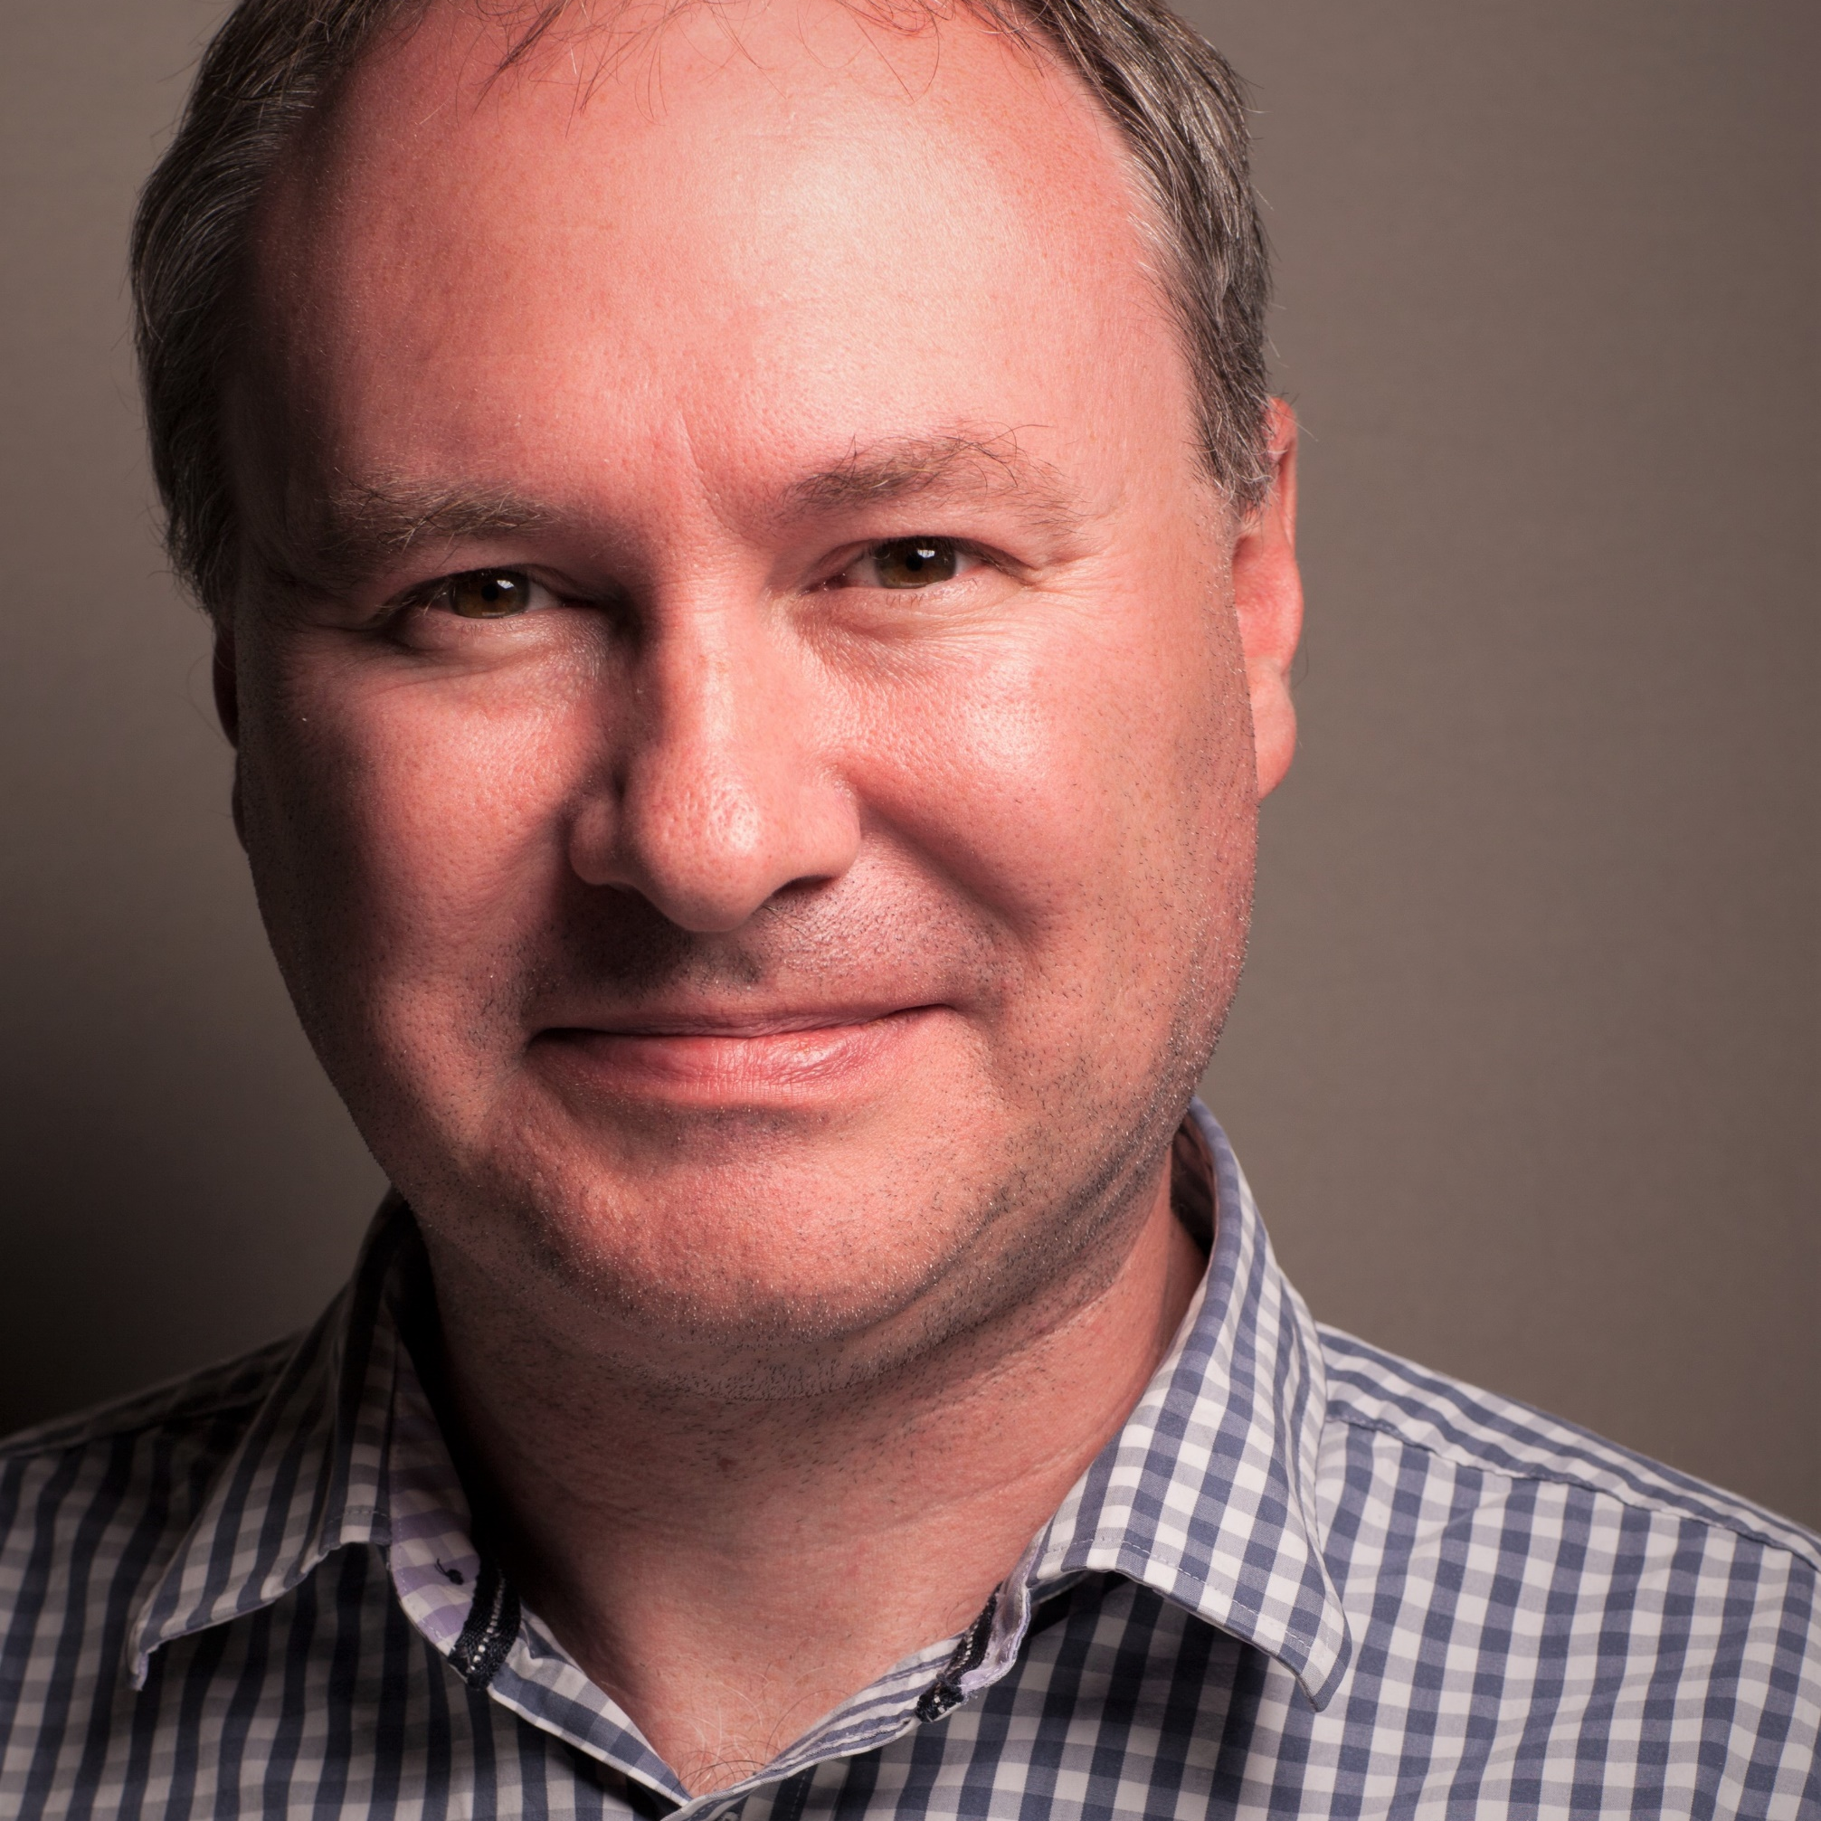
www.adiuvoengineering.com
adam@adiuvoengineering.com

